Slide 1

League Secretary Training

Slide 2

Introduction
This lesson is broken into six sections:
Meetings
The Organizational Meeting
Week One
League Certification
Weekly Duties
Season Wrap-up

Slide 3
Meetings

Slide 4
Meeting Notification
As league secretary, you will be responsible for notifying the appropriate league members of the date, time and place.

Slide 5
Quorum Definition
A quorum is the minimum number of members required to hold an official meeting.
At a meeting during the season, a quorum is a majority or one more than half.
At the organizational meeting a quorum is those present.

Slide 6

Determining a Quorum
We have a quorum?
Here!
Here!
Here!

Slide 7
Meeting Minutes
Minutes should include:
  Roster of those present and absent
  Any motions made
  Who made the motion
  Who seconded the motion
  Final outcome of any votes taken
  Brief summary
Minutes do NOT need to be verbatim

Slide 8
The Organizational Meeting

Slide 9
The Organizational Meeting
The league adopts its rules, finalizes rosters and makes decisions on any other matter which needs to be addressed before the league begins.

Slide 10
Adopting Rules
The board of directors, which consists of the team captains and league officers, are responsible for the adoption of rules unless the league rules specify the general membership adopts the rules.

Slide 11
USBC Benefits
USBC members receive:
A certified average
Tournament eligibility
Bonding of league prize fund
Standardized rules and equipment
Member Rewards

Slide 12
Finalizing Rosters
Go over the team rosters with each captain and note any vacancy a team may have.
Strikes & Spares
Vick Johnson
Torry Smith
Terri Jones
Joe Bowler
Steve Wonder
Kate Middle

Slide 13
Updating League Rules
For the league rules:
Update based on league decisions
Have President check rules
Make copies to pass out to league officers and team captains

Slide 14
WEEK ONE

Slide 15
It doesn’t have to be this way!

Slide 16
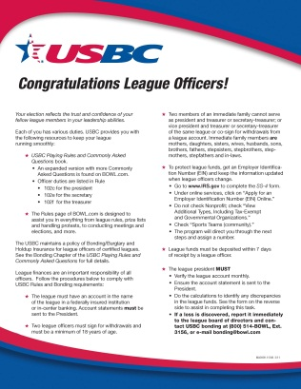

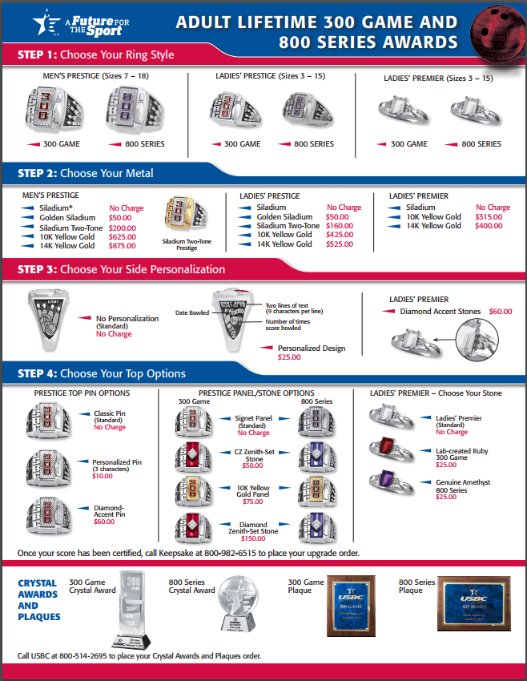
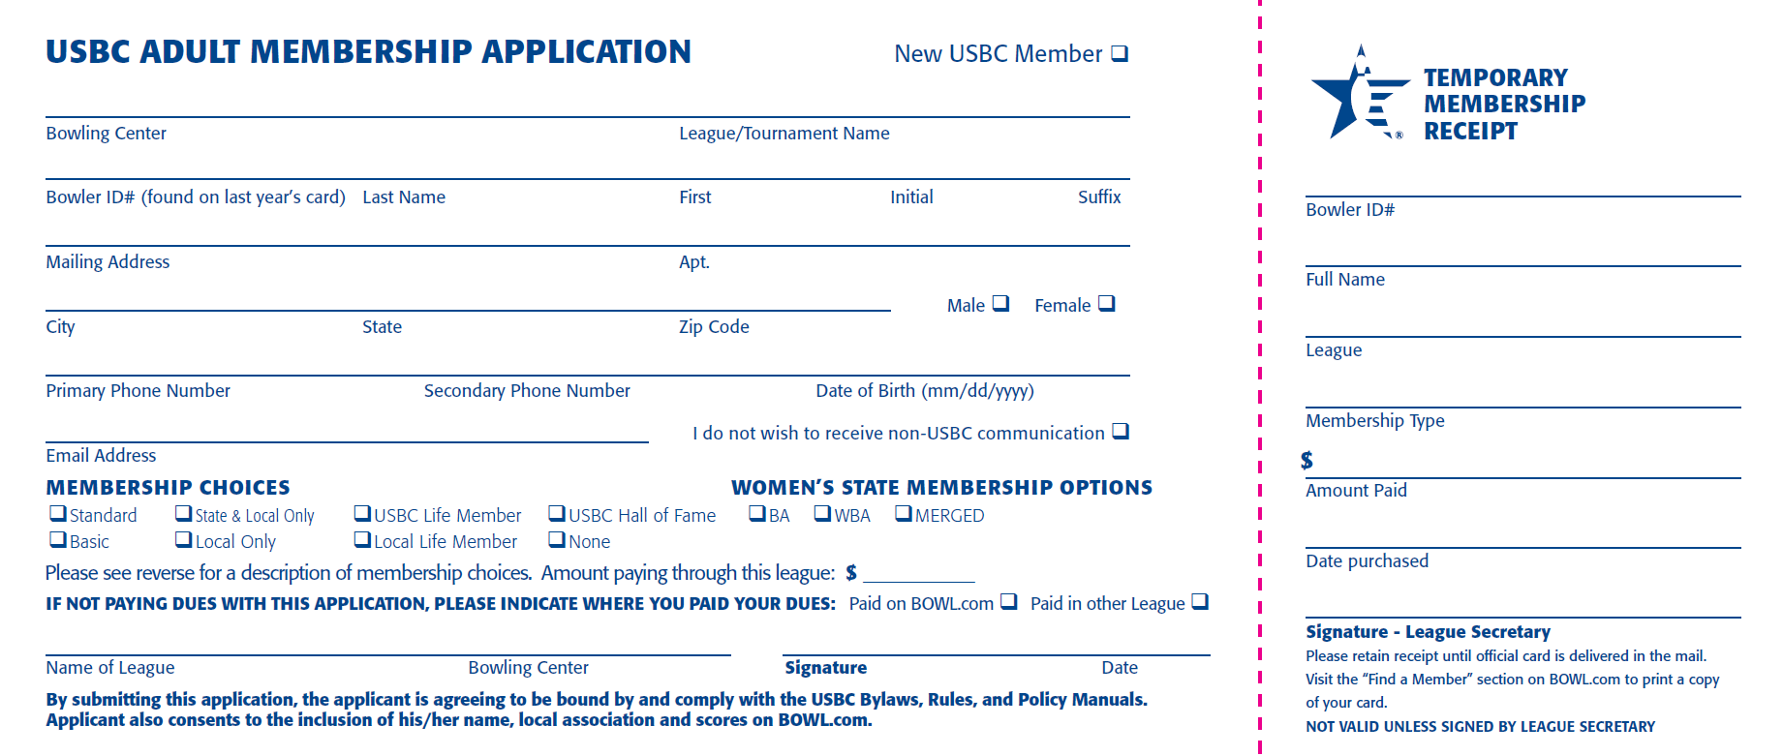
League Membership Package

Slide 17
Come Prepared
Your hand-out for each team should include:
League rules
Organizational Meeting minutes
Membership Applications

Slide 18
Assigning Team Numbers
If no rule has been adopted, assign numbers:
Based on finish position from previous season
By team names drawn from a hat
Based off previous season’s team number
In order as they get to the first night of league

Slide 19
League Night Responsibilities
Get there early
Set hand-outs on lanes
Greet teams as they come in
Introduce yourself to new members
Inform team captains what you handed out and where you are bowling

Slide 20
USBC Membership
USBC Rule 101 states:
  To be eligible to bowl in a USBC league, a bowler must:
  Complete an individual membership application in each league the bowler participates in.
  Pay or show proof of payment of USBC dues and the required association membership fees in effect for the current season before:
    Adult membership: Completion of the bowler’s first series.
    Youth membership: The bowler’s third session of competition.
  Any team using a player who has not satisfied USBC membership eligibility requirements subjects the games in which the bowler participated to forfeiture.

Slide 21
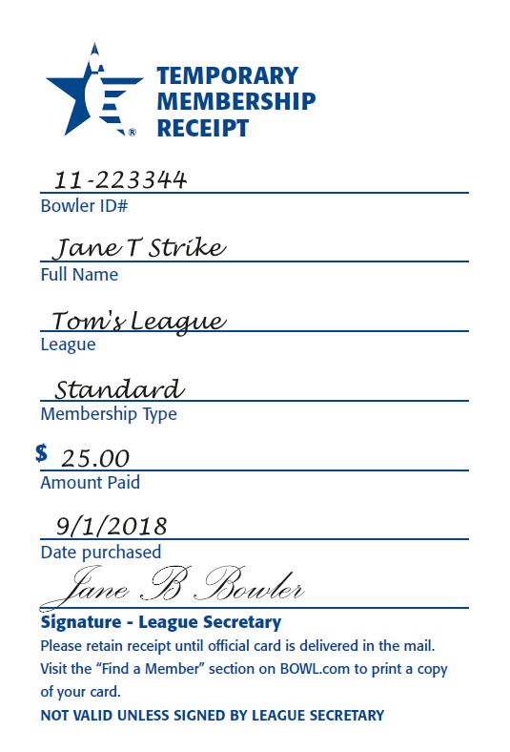
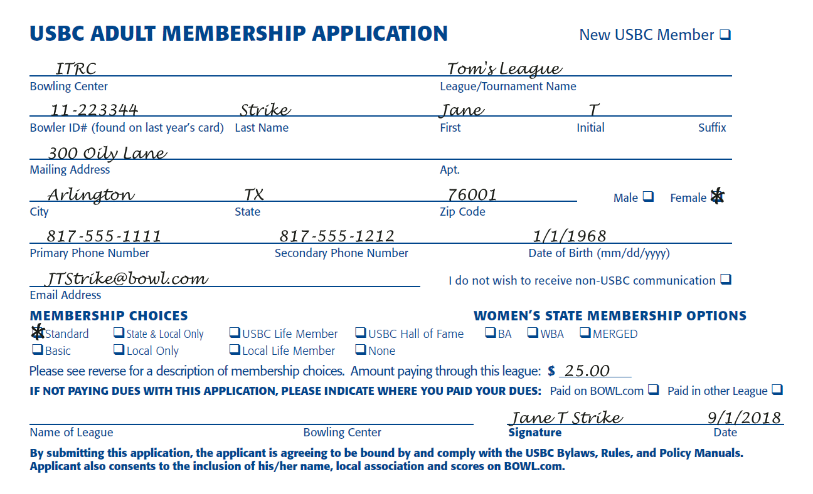
Membership Receipt

Slide 22
League Certification

Slide 23
Temporary Certification
Each USBC league is:
Temporarily certified for 30 days counting the first day of competition
Eligible for all membership services while temporarily certified

Slide 24
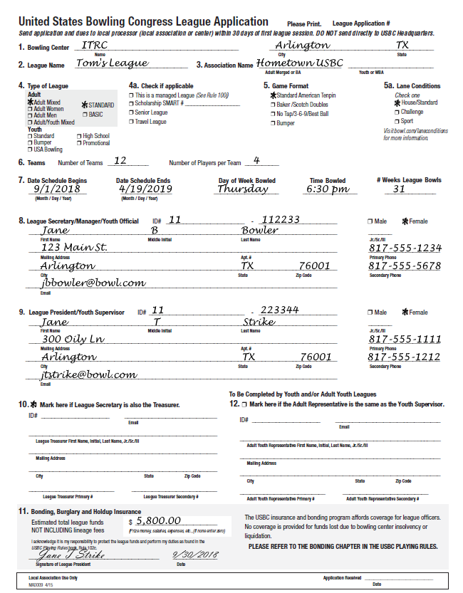
Certification Form
To insure there is no delay in certification of the league, make sure the league application is filled out entirely and correctly.

Slide 25
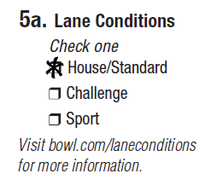
Lane Conditions

Slide 26


Schedule
One common mistake is secretaries not including the playoffs or any special contest as part of the schedule.

Slide 27
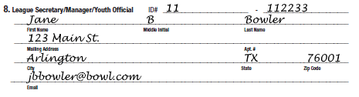
Officers
Make sure e-mail addresses for all officers are entered, accurate and current.

Slide 28

Bonding
Bonding amount includes total amount collected for the season for the prize fund, any salaries paid out and any expenses the league pays.

Slide 29

Signing the Application
The league president must sign the application.

Slide 30

Submission of Applications
30
Days

Slide 31
Weekly Duties

Slide 32
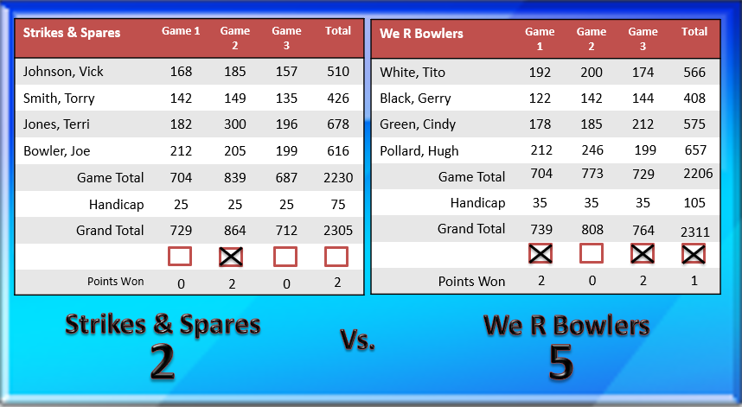
Entering Scores

Slide 33

USBC Awards

Slide 34
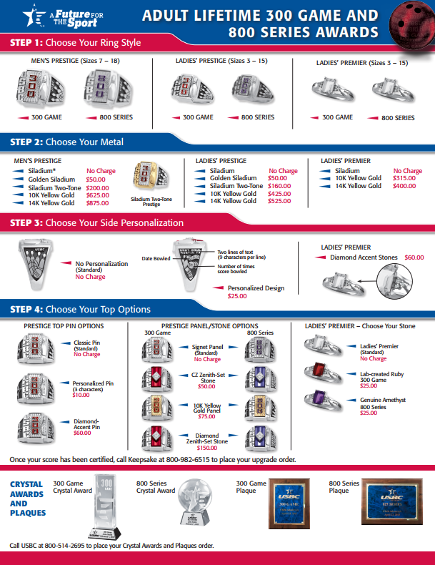
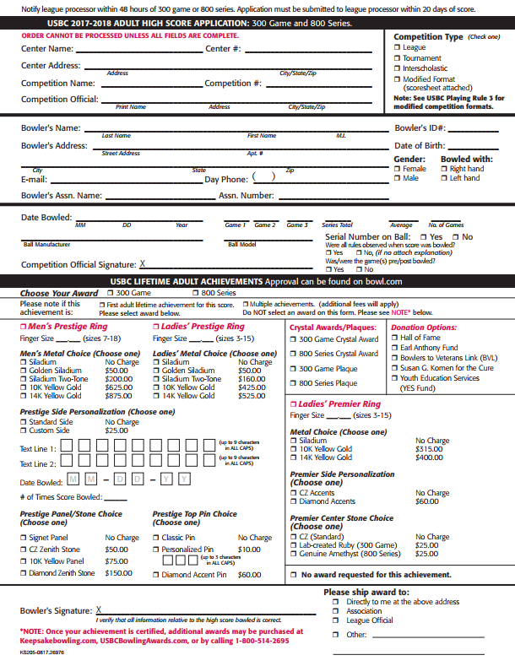
Award Applications

Slide 35
High Score Application
Ring Choice
Personalization
Bowler’s Signature

Slide 36
SUBMIT APPLICATION WITHIN 20 DAYS

Slide 37
Each Week
Come early
Have hand-outs on the lanes consisting of:
  Standing Sheet
  League record book or recap
Recognize award recipients
Have any new bowler fill out membership application

Slide 38
League Prize List
Must be presented for adoption by fifth week
  President responsible to see this is done
  Prize Committee presents options to board
Secretary distributes approved prize list
Prize list must receive majority vote
  If three or more are presented and no majority vote after first vote, prize list with lowest votes is thrown out

Slide 39
Weekly Routine
Enter scores into software
Calculate and distribute standings
Calculate averages
Apply for awards
Present awards
Answer questions from the bowlers

Slide 40
Season
Wrap-up

Slide 41

Year-end Meeting
Leagues have one final meeting to distribute prizes and elect new officers.

Slide 42

Final Standings
In order for the league members to be paid their prize money, you will need to print out one last standing sheet for the League Treasurer.

Slide 43
Officer Elections
Elections shall be held before the distribution of the prize fund unless the league rules state otherwise.
All league officers must be a member of USBC.

Slide 44
Final Averages
Submit averages of all bowlers regardless of the number of games, including substitutes to the local association.

Slide 45
Local Association Meetings
Notify league members of the date, time and place of any local association membership meeting.

Slide 46
League Records
Rule 102e, item 8 requires all league property to be turned over to the newly elected secretary.

Slide 47
Congratulations!

